Slide 1
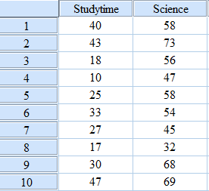
Linear Regression: Example

Slide 2
Example: Interpretation
The R Square value is the Model summary table shows the amount of variance in the dependent variable that can be explained by the independent variable.
In our example, the independent variable of study time accounts for 51.9 % of the variance in the scores of the science exam.
The R value (0.721) indicates that as study time increase the science score also increases, and this is a positive correlation, with r = 0.721.
We know this to be statistically significant from the Pearson correlation output.

Slide 3
Example: Interpretation
The Adjusted R Square adjusts for a bias in R Square.
R² is sensitive to the number of variables and scores there are, and adjusted R² corrects for this.
We can see from the table that F(1, 8) = 8.647, p < 0.05, and therefore can conclude that the regression is statistically significant.

Slide 4
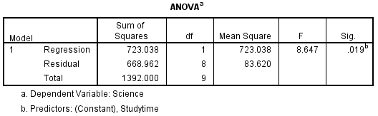
Example: Interpretation
The ANOVA tests the significance of the regression model.
In our example does the independent variable, study time explain a significant amount of the variance in the dependent variable: science exam result?
As with any ANOVA the essential pieces of information needed are the degrees of freedom, the F value, and the probability value.

Slide 5
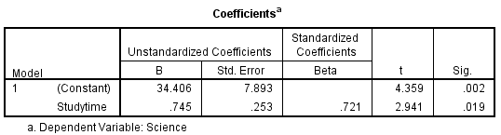
Example: Interpretation
The unstandardized coefficients B column gives us the value of the intercept (for the constant row) and the slope of the regression line (from the study time row).
This gives us the following regression equation:
Science exam score = 34.406 + 0.745 study time.
The Standardized Beta Coefficient column informs us of the contribution that an individual variable makes to the model.

Slide 6
Example: Interpretation
From the above table, we can see that study time ‘contributes’ 0.721 to science exam performance, which is our Pearson’s r value.
The t value (t = 4.539, p < 0.01) for constant tells us that the intercept is significantly different from zero.
The value for study time (t = 2.941, p < 0.05) show that the regression is significant.

Slide 7
Multiple correlation
In multiple correlation, we study three or more variables at a time.
Whereas in case of partial correlation we study the relationship of two variables by making the other factors constant.
In case of multiple correlation the effect of all the independent factors on a dependent factor is studied.
The coefficient of multiple linear correlation is represented by R and the necessary subscripts are added to it.
If there are three variables X₁, X₂ and X₃ then
R_{1.23} = Multiple correlation coefficient with X₁ as dependent variable and X₂ and X₃ as independent variables.

Slide 8
Partial correlation
Partial correlation is special case of multiple correlation.
A partial relation is between two variables excluding the effect of the others.
Partial correlation is also called net correlation.
It is a study of the relationship between one dependent variable and one independent variable by keeping the other independent variables constant.
Simple correlation between two variables is called the zero order coefficient as in simple correlation no factor is held constant.

Slide 9
Partial correlation
If a partial correlation is studied between two variables by keeping a third variable constant it would be called a first order coefficient as on variable is kept constant.
e.g. r_{12.3} which means that a partial correlation is being studied between variables (1) and (2) while the third variable is kept constant.
If a partial correlation is studied between two variables by keeping two other variables constant it would be called a second order coefficients as two variables are kept constant.
e.g. r_{12.34} which means that a partial correlation is being studied between variables (1) and (2) while the (3) and (4) variables are kept constant.

Slide 10
Partial correlation
We have analysed example data to show a significant correlation between study time and science examination performance.
We might decide a third variable, intelligence, could be influencing the correlation.
If intelligence positively correlates with study time, that is, the more intelligent students spend the most time studying; and if it also positively correlates with examination performance, that is, more intelligent students get the higher marks in the examination, then the correlation of study time and examination performance might simply be due to the third factor ‘intelligence’.

Slide 11
Partial correlation: Example
To answer the question of the influence of intelligence on the study time/examination performance correlation we need to examine the correlation of study time and examination performance after removing the effects of intelligence.
If the correlation disappears then we know it was due to the third factor.
To do this we calculate a partial correlation.

Slide 12
Partial correlation: Example
Study time | Science | Intelligence
40 | 58 | 118
43 | 73 | 128
18 | 56 | 110
10 | 47 | 114
25 | 58 | 138
33 | 54 | 120
27 | 45 | 106
17 | 32 | 124
30 | 68 | 132
47 | 69 | 130

Slide 13
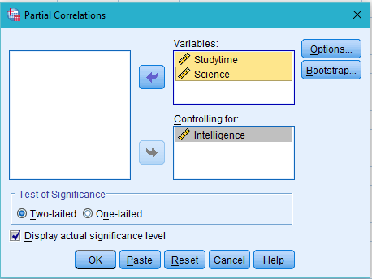
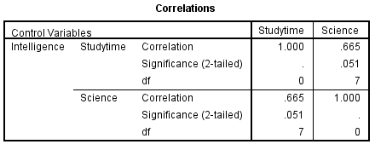
Partial correlation: Example

Slide 14
Example: Interpretation
The correlation test statistic = 0.6653.
The p value is shown to be 0.025. As this value is under 0.05 there is a significant correlation.
A conventional way of reporting these figures would be r = 0.6653, degrees of freedom = 7, p < 0.05.
These results indicate that as study time increases science exam performance also increases, when the effects of intelligence have been controlled for.
This is a positive correlation. So, the relationship between study time and science exam performance is not a result of intelligence.

Slide 15
Multiple Regression
Multiple regression analysis represents a logical extension of two variable regression analysis.
Instead of single independent variable, two or more independent variables are used to estimate the vales of a dependent variable.
If there are three variables X₁, X₂ and X₃ the multiple regression will take the following form:
X₁=a_{1.23} + b_{12.3} X₂ + b_{13.2} X₃

Slide 16
Multiple Regression: Example
The following data relate to performance of 8 salesman
Salesman | Sales Performance (in 000 Rs.) (x1) | Test Score (X2) | Effort Index (X3)
1 | 60 | 45 | 0.9
2 | 70 | 80 | 0.3
3 | 90 | 70 | 1.2
4 | 90 | 85 | 0.5
5 | 70 | 60 | 0.4
6 | 80 | 55 | 1.6
7 | 60 | 75 | 0.1
8 | 120 | 90 | 2.0

Slide 17
Multiple Regression: Example
Find out the regression line of x₁ on x₂ and x₃.
Our regression line is
X₁=a_{1.23} + b_{12.3} X₂ + b_{13.2} X₃
Answer:
X₁ = 5.798+0.788X₂ + 21.786X₃

Slide 18
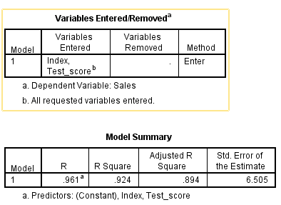
Multiple Regression: Example

Slide 19
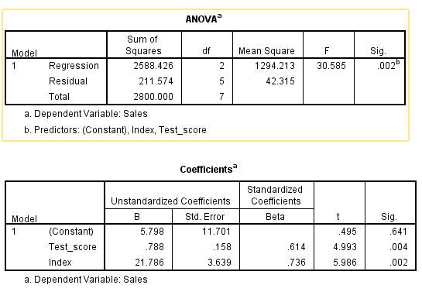
Multiple Regression: Example

